Slide 1

PREDICTIVE INSIGHTS AI
AI risk forecasting for EU AI Act alignment
Local, private models and study tools for teams that have to show how a cybersecurity decision was made.
Predictive Insights AI · 2026
1 / 20

Slide 2
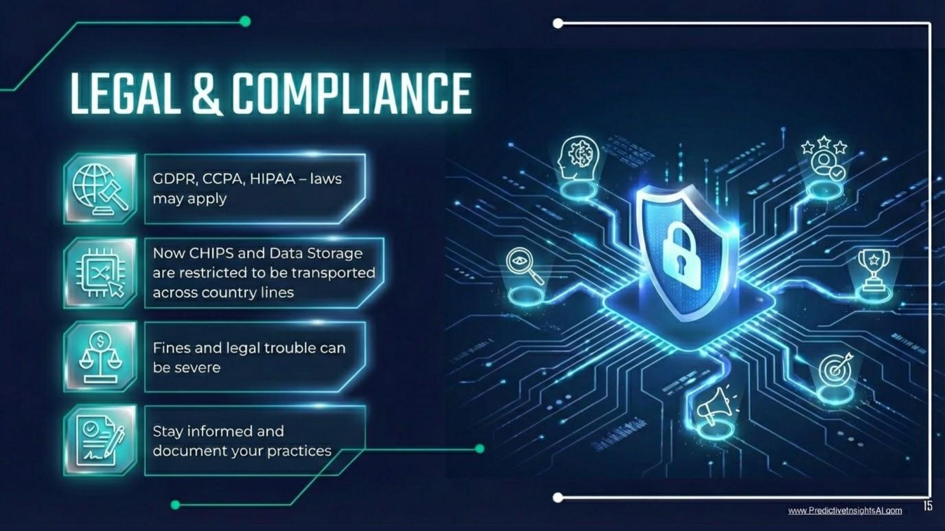
Problem
Tools for AI-driven cybersecurity mastery are expensive.
Generative AI is introducing new cyber risks and vulnerabilities.
Businesses are lagging on compliance, including the EU AI Act, SOC 2, and NIST.
Compliance lesson from the site.
Predictive Insights AI · 2026
2 / 20

Slide 3
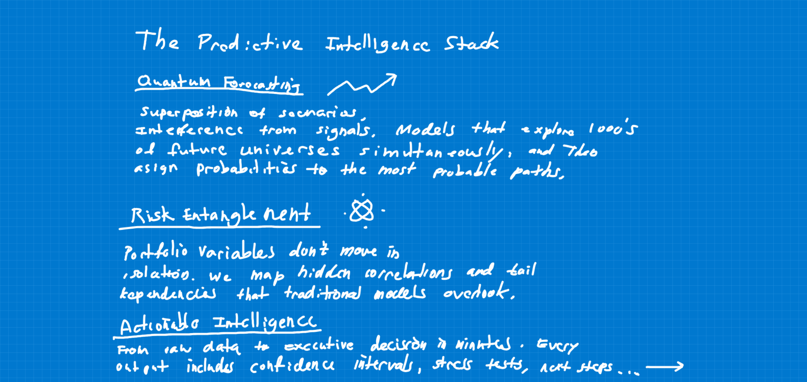
Solution
Pre-trained predictive models and LLMs for real-time simulations.
Memorization flashcards, apps, and self-study modules on best practices.
The same three layers are on the home page: quantum forecasting, risk entanglement, and actionable intelligence.
Predictive Intelligence Stack, from the whiteboard notes.
Predictive Insights AI · 2026
3 / 20

Slide 4
Proposition
Local, private AI for cybersecurity predictions.
A decentralized Tailscale network with blockchain logging.
Access includes 12 datasets, 15 exercises, and 200 hours of video.
Predictive Insights AI · 2026
4 / 20

Slide 5
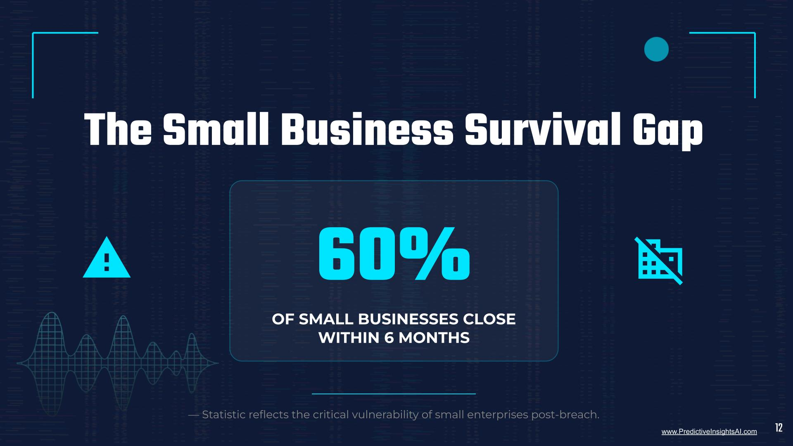
Existing alternatives
Big Tech platforms with high barriers for small and midsize businesses.
Shortcuts such as basic antivirus, which miss predictive insights.
Small-business lesson from the site: 60% close within 6 months of a breach.
Predictive Insights AI · 2026
5 / 20

Slide 6
Key metrics
43k
Visitors in the first two weeks of the 2026 relaunch.
Predictive Insights AI · 2026
6 / 20

Slide 7
Partnerships
Past partner: Capital Factory (Austin), for acceleration.
Past partner: AWS Startups, for infrastructure.
Integrated Security Consultants (ISCSecurity.net), for expertise.
Predictive Insights AI · 2026
7 / 20

Slide 8
Cost structure
Master’s degree.
Software and cloud services.
Credentialing (SOC 2, NIST), course development, and marketing.
Predictive Insights AI · 2026
8 / 20

Slide 9
Unfair advantage
Business license is pending.
Founder Sam Castillo’s brand and network.
Seven years in predictive modeling.
Predictive Insights AI · 2026
9 / 20

Slide 10
Channels
Media, press, and podcasts.
University partnerships in the Five College Area.
YouTube, built from zero to 50,000+ lifetime views.
Public lectures on Rumble, including Exam PA and machine-learning lessons.
Predictive Insights AI · 2026
10 / 20

Slide 11
Customer segments
Healthcare facilities and insurance companies
HR specialists
Actuaries and financial analysts
Educators and administrators
Paralegals and lawyers
Engineering and operations
Predictive Insights AI · 2026
11 / 20

Slide 12
Early adopters
2
Fortune 500 companies.
Predictive Insights AI · 2026
12 / 20

Slide 13
Revenue streams
$2,000 B2B subscriptions.
Training enrollment bookings.
Research grants.
Predictive Insights AI · 2026
13 / 20

Slide 14
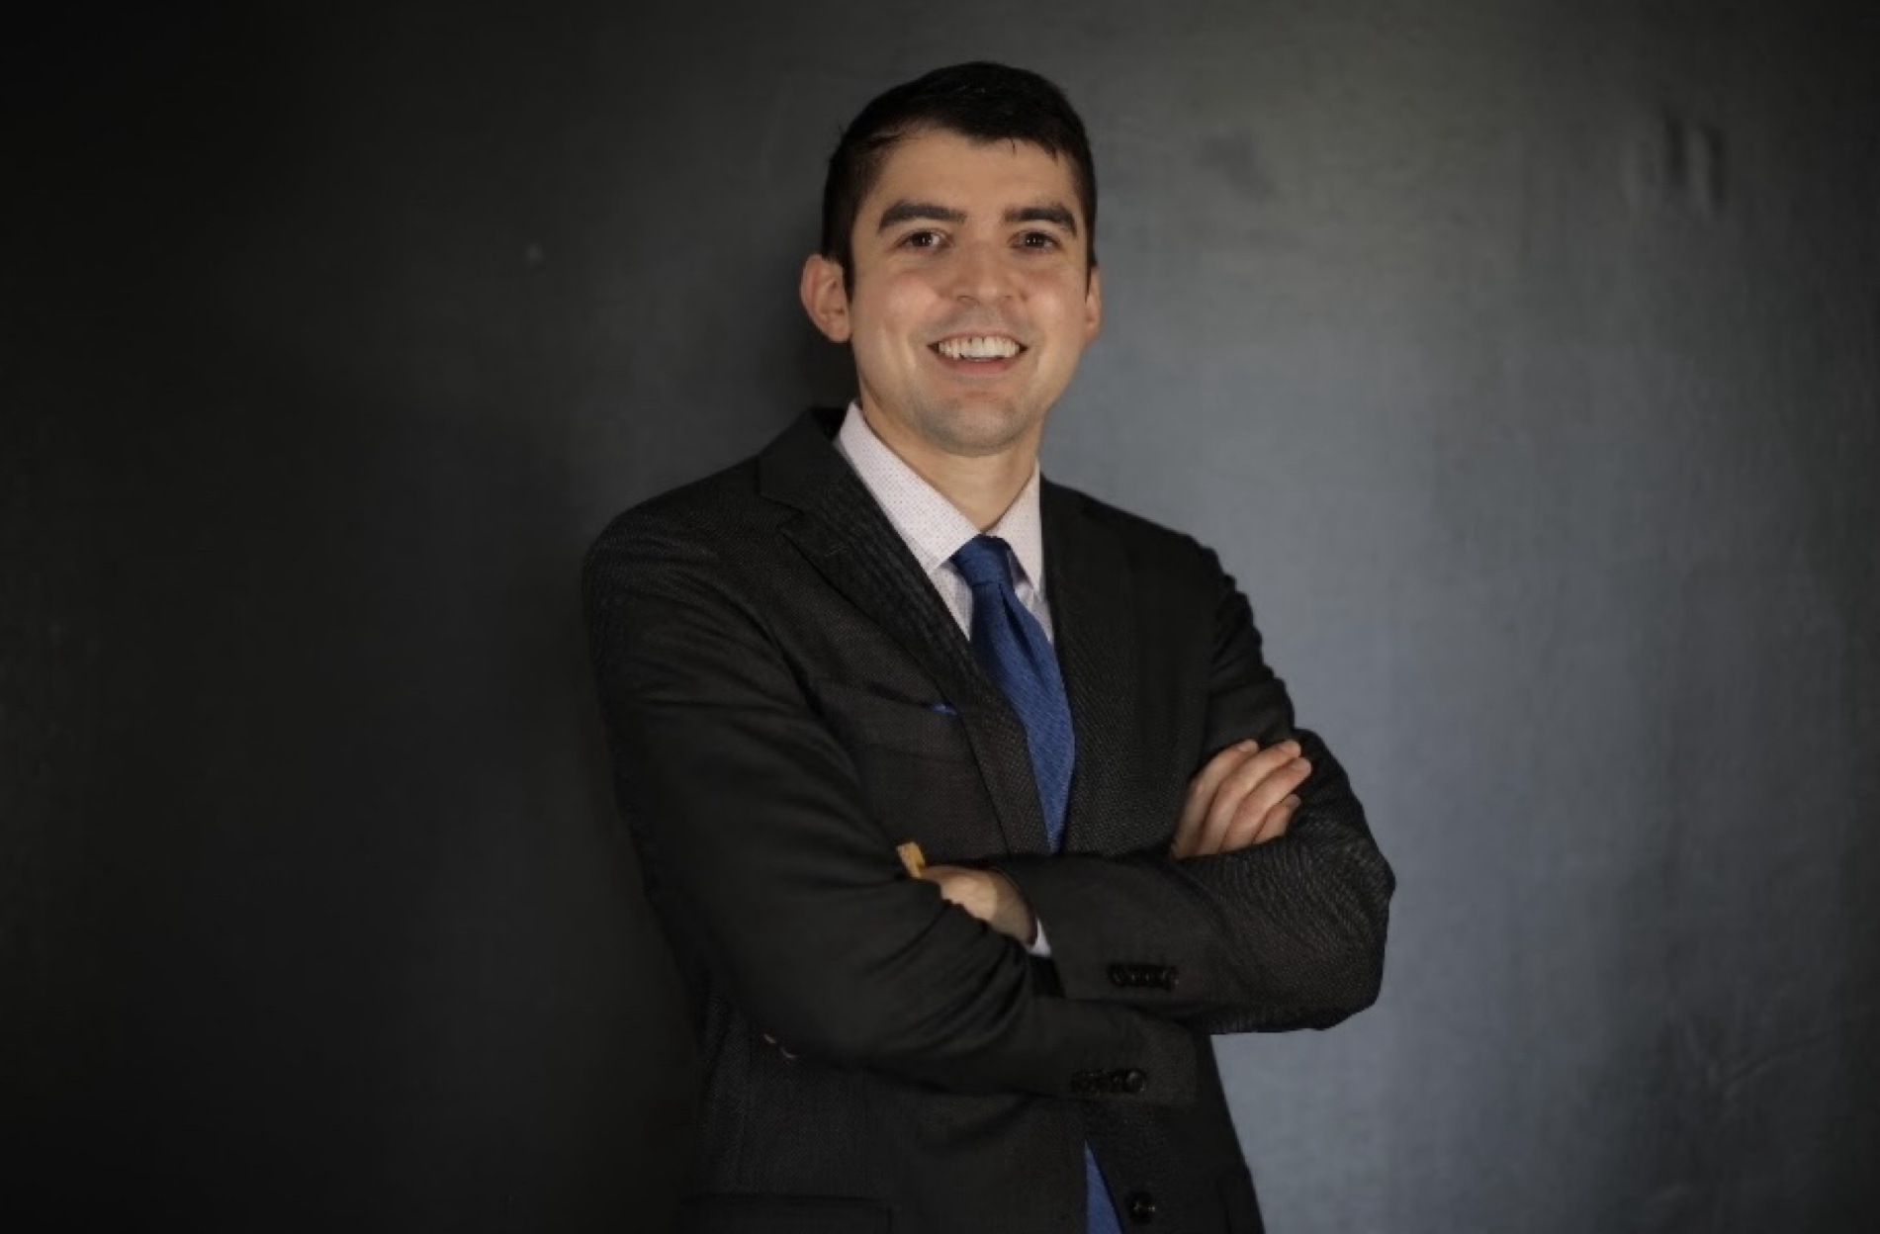
ABOUT
Samuel Castillo
Massachusetts founder. He studied mathematics and actuarial science at UMass Amherst and built a small business after corporate roles.
7+ years of actuarial and data science experience at Fortune 500 companies.
Founder with startup accelerator experience.
Completed the AI Fundamentals course by Google on Coursera.
Exam P
Exam PA
Exam MFE / 3F
Exam STAM
Exam FM
About
Identity
Predictive Insights AI · 2026
14 / 20

Slide 15
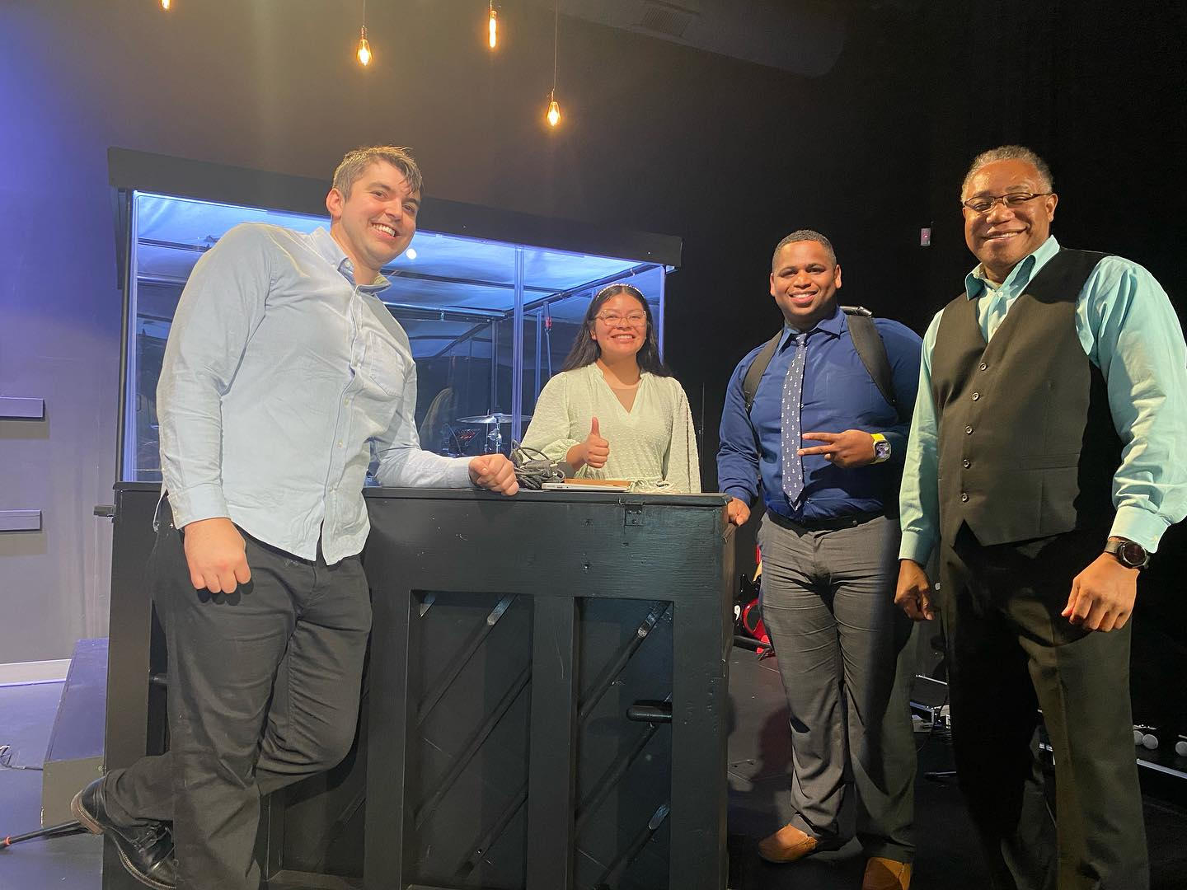
Experience
Integrated Security Consultants, Inc. — AI Solutions Developer, 2025. Turned security-system installs into clear steps and trained LLMs as virtual tech guides.
Pass My Exam, LLC — Product Developer, 2024. AWS Activate Startups. YouTube channel from zero to 50,000+ lifetime views.
Expedia Group — Data Analyst, 2022–2023. Predictive models on global travel data. Workflows cut from 3 days to hours.
On stage during a keynote presentation.
Predictive Insights AI · 2026
15 / 20

Slide 16
What people say
He discovered patterns in the data that I never expected to see, pairing his expertise with my industry knowledge perfectly. I’d strongly recommend Sam for any data task you may have.
Veteran entrepreneur, February 2022
Sam is making predictive analytics approachable and accessible to new talent in the actuarial field. It’s a tough subject and a hard thing to do, but he has proven he’s up to the task.
Mentor, product and education advisor, January 2021
Sam took action and created a data visualization survey to better understand which tools others were using so that we could tailor design decisions to match our end users. He also helped to create an R library called mr_workflow for R users within the firm.
Senior product manager, healthcare analytics, January 2021
I do not sell your information.
All eight testimonials
Privacy
Predictive Insights AI · 2026
16 / 20

Slide 17

Work on the site
ASA DataFest 2025. The action items below are from the commercial real-estate analysis published on the site.
ASA DataFest 2025 write-up
Predictive Insights AI · 2026
17 / 20

Slide 18
EU AI Act upskilling
$150B
Total education cost. People, multiplied by the average cost of materials, multiplied by the certifications each person needs.
20 million
Professionals affected worldwide
$2,500
Average cost of study materials
3
Certifications or tests per person
$150 billion
Total education cost
×
×
=
Predictive Insights AI · 2026
18 / 20

Slide 19
Compared with actuarial education
Affordable tools are a way to bring compliance costs down. The same formula — people × materials × exams — is much smaller in the actuarial market.
31,000
Actuaries
$3,500
Study materials
10
Exams
$1.085 billion
Education cost on this formula
×
×
=
Set next to the $150 billion EU AI Act figure, actuarial education is the smaller, better-known market for the same kind of study spend.
Predictive Insights AI · 2026
19 / 20

Slide 20
NEXT
A forecast you can explain
Private cybersecurity predictions, study modules, and a record of how the result was produced.
Contact Samuel Castillo
Predictive Insights AI · 2026
20 / 20

